Slide 1

Introduction to Unit Testing and Mocking
Joe Wilson, President
Volare Systems, Inc.
Email: joe@volaresystems.com
Office: 303-532-5838, ext 101
Web: http://VolareSystems.com
Blog: http://VolareSystems.com/Blog
Twitter: joe_in_denver

Slide 2

Quick Audience Poll
Who has done unit testing?
Who has tried and given up?

Slide 3
Agenda
What is unit testing?
Step-by-step
What is mocking?
Dos and Don’ts

Slide 4
What is unit testing?
Testing one thing at a time
Not touching anything external (DB, file, etc.)
The developer’s job
Writing and refactoring code

Slide 5
Benefits of unit testing
Safer refactoring
Smaller, tighter, decoupled code
Documentation of requirements
Continuous integration
Value of tests increase over time

Slide 6
Benefits of unit testing
Rev 1
Rev 2
Rev 3
Benefit
$
Cost
Time – Life of System

Slide 7
Where does unit testing fit?
Still need manual testing, hopefully less
Still need integration testing
Still need user-acceptance testing
May want UI testing
May want performance testing

Slide 8
What do you need?
Testing framework
NUnit, MSTest, MbUnit
Test runner
NUnit, MSTest, ReSharper, TDD.NET
Mocking framework
Rhino Mocks, Moq, TypeMock

Slide 9
When do you write the test?
Before coding (TDD, BDD)
After/During coding
Focus on requirements
Thinking about how code will be consumed
Stop coding when reqs met
Harder initially
Focus on code
Thinking about algorithm
More refactoring
Easier initially

Slide 10
Recipe – Unit Test Project
One unit test project
Name it after your solution, like *.UnitTests
Use Project Folders inside the project for namespaces
Set testing framework and project references

Slide 11
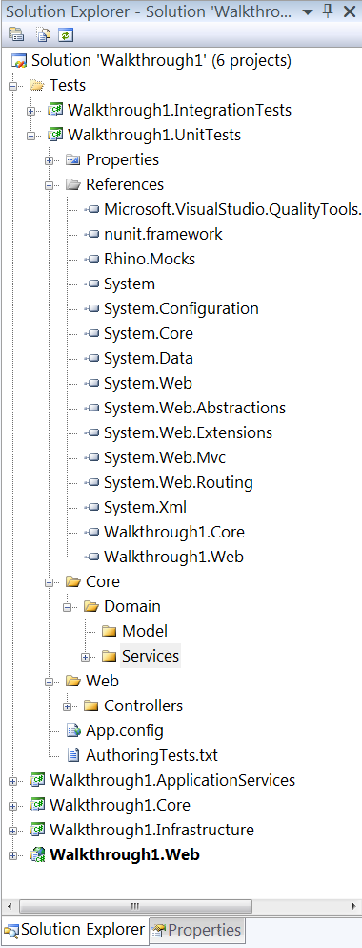
Recipe – Unit Test Project
Create unit test project
Add references
Create project folders

Slide 12
Recipe – Unit Test Class
One unit test class per class under test
Name it for your class under test, like *Tests
Add using for testing framework
Add [TestFixture] attribute

Slide 13
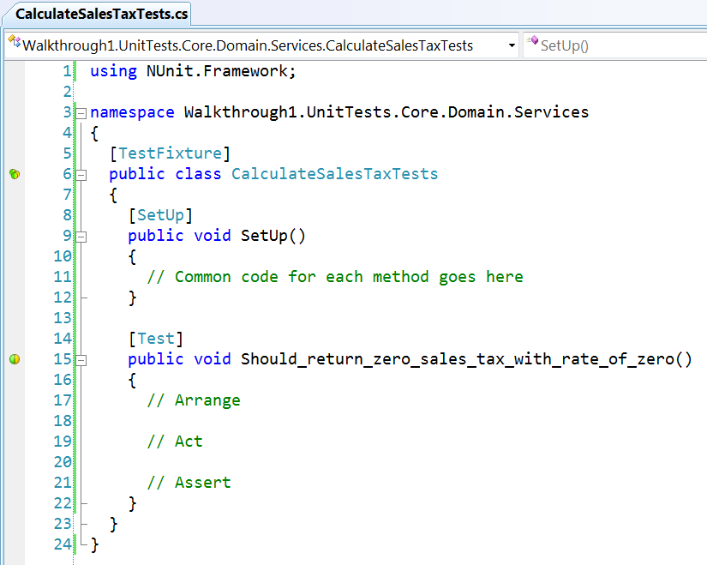
Recipe – Unit Test Class
Using
Test class per class
Name *Tests
[TestFixture] attribute

Slide 14
Recipe – Unit Test Method
One unit test method per scenario
Add [Test] attribute to a void method
Popular method naming patterns:
Should_<outcome>_when_<condition>()
<MethodUnderTest>_<condition>_<outcome>()
BDD style – class and method names are specs

Slide 15
Recipe – Unit Test Method
[Test] attribute
Void method
Test method per scenario

Slide 16
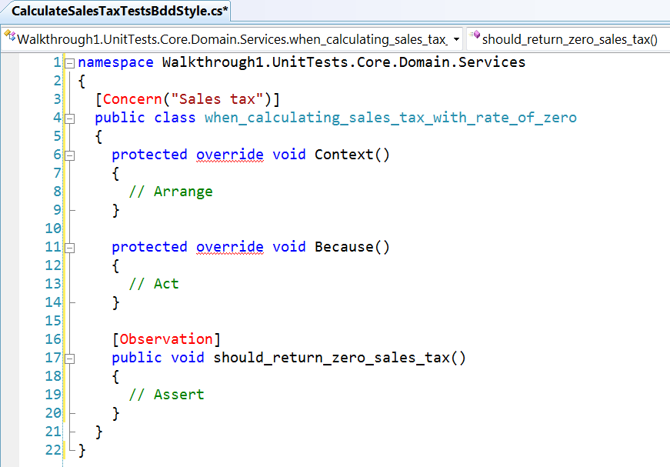
Recipe – Unit Test Method (BDD Style)
Context
Because
Observation

Slide 17

Recipe – Arrange, Act, Assert
Arrange
Setup code, prerequisites, etc.
Act
One line
Exercise method under test
Assert
One logical assert per test

Slide 18
Recipe – Arrange, Act, Assert
Start with Act to hit the method
Move onto Arrange to set conditions
End with Asserts

Slide 19
Code!

Slide 20
Recipe – Pull Out a Dependency
Wrap dependency with an interface
Create a private field of interface type
Add interface as an argument in the constructor
Assign private field to argument in constructor
Use the new private field in code

Slide 21
Code!

Slide 22
What is mocking?
Creating fake objects for you
Nothing you can’t do manually
Set and inspect values on a fake object
Inspect method calls and args on a fake object

Slide 23
Two kinds of unit tests
Black Box
State
White Box
Interaction

Slide 24
Stub vs. Mock
Stub
Mock
Get/Set properties
Set method return values
Test state
Check method calls
Check arguments used
Test interactions

Slide 25
Recipe – Mocking*
Use the MockRepository.GenerateMock<T>()
If you need a return value, use myMock.Stub().
If the mock is a void, use the myMock.AssertWasCalled().
* Paraphrased from Jimmy Bogard’s Los Techies blog

Slide 26
Code!

Slide 27
Unit Testing Dos
One test per scenario
One logical assert
Code to abstractions, wrap difficult code
Prefer state testing over interaction
AAA syntax to keep organized
Use mocking tool for dependencies

Slide 28
Unit Testing Don’ts
Ignore failing tests (fix them immediately)
Test code you didn’t write (BCL, 3rd party)
Order tests (integration test)
Overuse Setup or Teardown (integration test)
Overuse Arrange (may need to refactor)

Slide 29
Resources
Books
“Art of Unit Testing” - Roy Osherove
“Test-Driven Development in Microsoft .NET” – James Newkirk
“Pragmatic Unit Testing in C# with NUnit” – Andy Hunt, Dave Thomas
Testing Frameworks
NUnit - http://www.nunit.org
MbUnit - http://www.mbunit.com
Mocking Frameworks
Rhino Mocks- http://www.ayende.com/projects/rhino-mocks.aspx
Moq - http://code.google.com/p/moq
TypeMock - http://site.typemock.com
Email: joe@volaresystems.com
Office: 303-532-5838, ext 101
Web: http://VolareSystems.com
Blog: http://VolareSystems.com/Blog
Twitter: joe_in_denver

